Slide 1
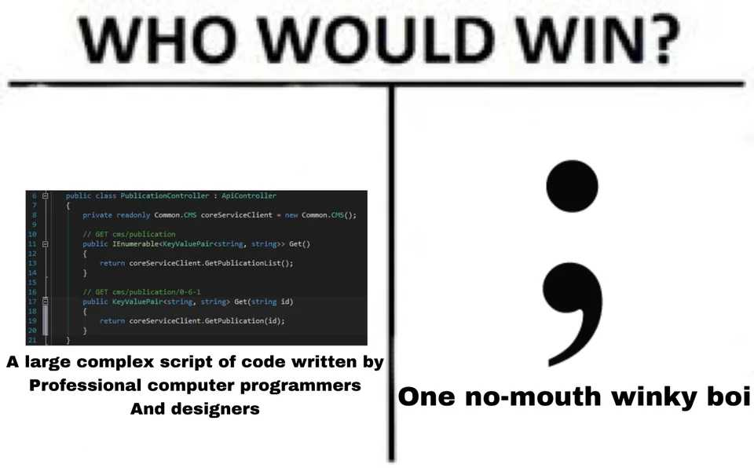

Slide 2
Defining Classes
CS2308
Gentry Atkinson

Slide 3
Structs vs. Classes
structs and classes create new data types by combining primitive data types.
Users have access to all members of a struct.
We can write separate functions to manipulate the members of a struct.
Classes let us combine data and functions into a single package.

Slide 4
What is a Class?
Private
Class
Data
“Setter” Functions
Rest
of the
Program
“Getter” Functions
Public
Interface

Slide 5
What is a Class?
A class defines an abstraction used in a program not just in terms of what they “know”, but also what they “do”.
Restricts access to private data to ensure that it is used “safely” and “correctly”.
The class is the definition. An instance of a class in memory is called an object.

Slide 6
Limited Access
The keywords private and public can be used define which class members can be accessed from outside the class.
private members can be accessed by the class itself, but not from outside the class.
Data should be kept private as much as possible.
public funcitons are used to access private data.

Slide 7
Example 1
class Circle{
private:
const float PI = 3.14159;
public:
float radius, circum, area;
};
int main(int argc, char** argv){
Circle c;
cout << c.PI << endl;
} //causes an error

Slide 8
Member Functions
classes collect both data and functions into one package.
Member functions can be called methods.
Member functions are called using the member access dot . operator, just like member data.
Member functions can be public or private.
Member functions have access to private class members.

Slide 9
Example 2
class Circle{
private:
const float PI = 3.14159;
public:
float radius, circum, area;
void setMembers(float radius){
this->radius = radius;
area = PI*(radius*radius);
circum = PI*(2*radius);
}
};

Slide 10
Example 2 cont.
int main(int argc, char** argv){
Circle c;
c.setMembers(5);
cout << c.area << endl;
} //try to guess the output

Slide 11
Getters and Setters
Using member functions to initialize, update, and retrieve the values stored in member variables means that we can always insure that the values are “correct”.
Getters: retrieve a private value from a class. Also called accessors.
Setters: alter the value of a private member of a class. Also called mutators.
Data and functions should always be as private as possible.

Slide 12
Example 3
class Circle{
private:
const float PI = 3.14159;
float radius, circum, area;
public:
void setRadius(float r){radius = r;}
void setArea(){ area = PI*(radius*radius);}
void setCircum(){circum = PI*(2*radius);}
  float getArea(){return area;}
};
int main(int argc, char** argv){
Circle c;
c.setRadius(5);
c.setArea();
cout << c.getArea() << endl;
} //try to guess the output

Slide 13
Constructors and Destructors
Constructors run automatically when a class is instantiated.
Destructors run automatically when a class is deleted.
Constructors must have the same name as the class.
Destructors are named ~ + Class Name.
As member functions, constructors and destructors can access private members, but must be public.

Slide 14
Example 4
class Circle{
private:
const float PI = 3.14159;
float radius, circum, area;
public:
Circle(float r){
radius = r;
area = PI*(radius*radius);
circum = PI*(2*radius);
}
float getArea(){return area;}
};
int main(int argc, char** argv){
Circle c(5);
cout << c.getArea() << endl;
} //try to guess the output

Slide 15
Class vs. Object
A class is a definition of a new data type, like a struct.
Create a variable with the type of a class is called “instantiating” a class.
An object is a variable with the type of a class which exists in memory.

Slide 16
Questions or Comments?

